Slide 1
Westward Expansion
Manifest Destiny

Slide 2
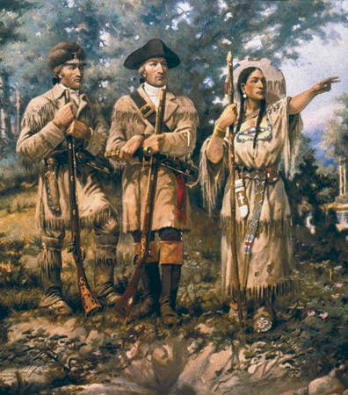
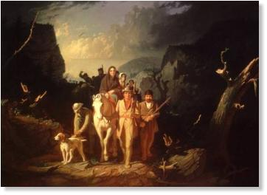
History of Western Movement
Ever since the beginning of the United States, Americans have always had an intense desire to expand and move westward
One of the main causes of the American Revolution
Louisiana Purchase
Lewis and Clark Expedition
U.S. had grown rapidly in relatively short time

Slide 3
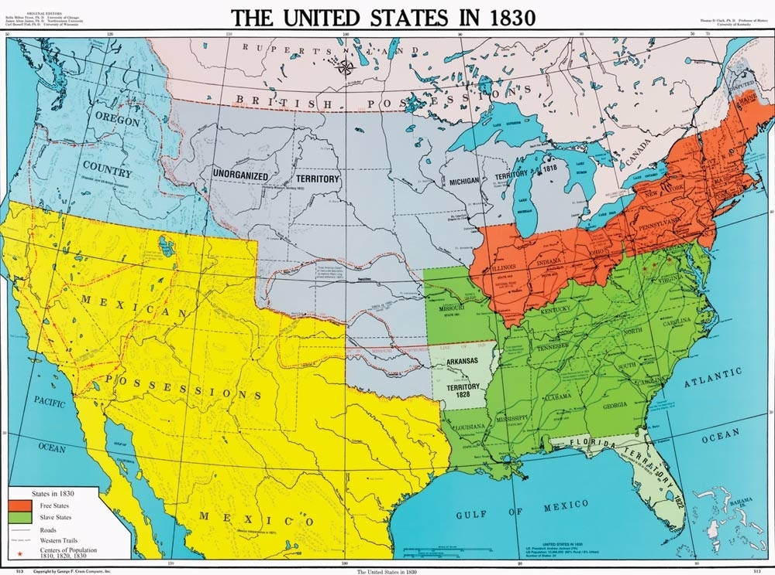

Slide 4
Manifest Destiny
By the 1840s, this desire to move west and for the U.S. to stretch from across the continent had almost become an obsession
Many Americans believed that the nation had a MANIFEST DESTINY to fulfill by extending from “sea to shining sea”

Slide 5
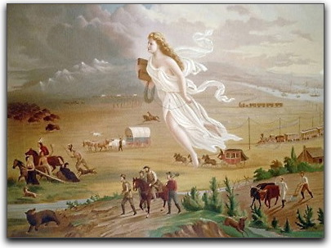

Slide 6
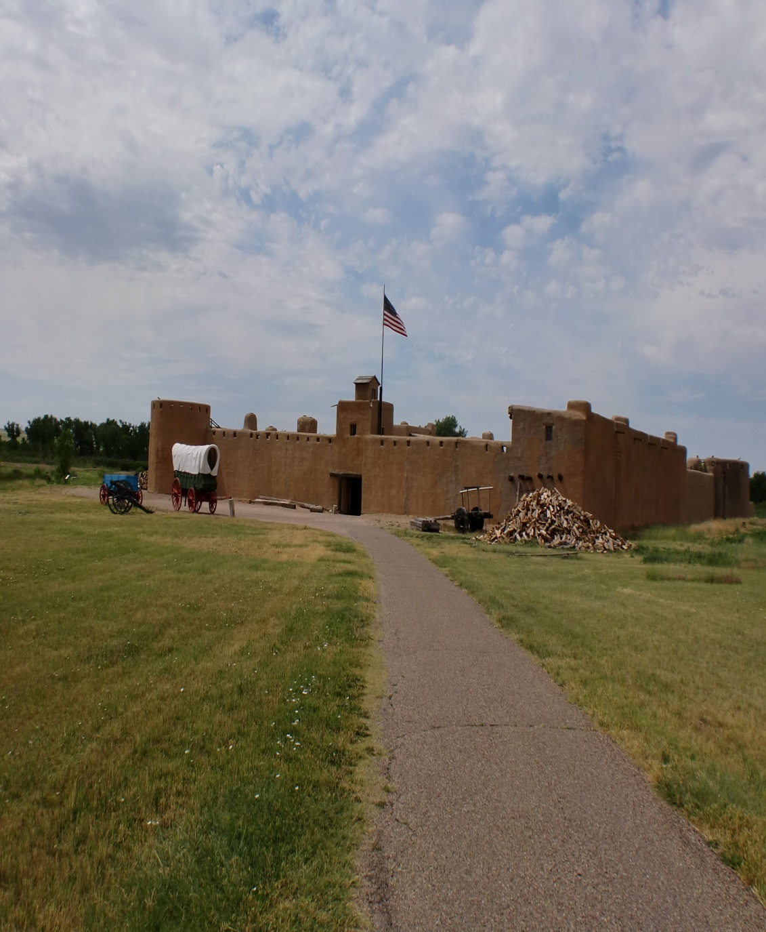
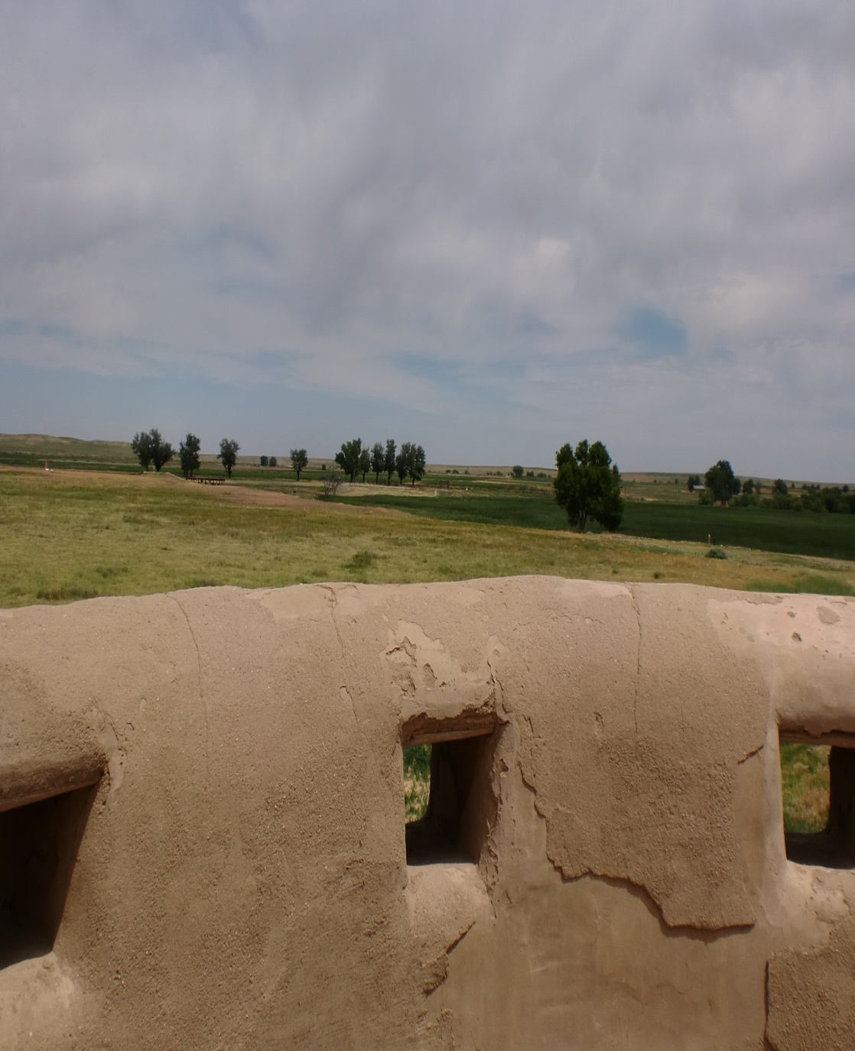
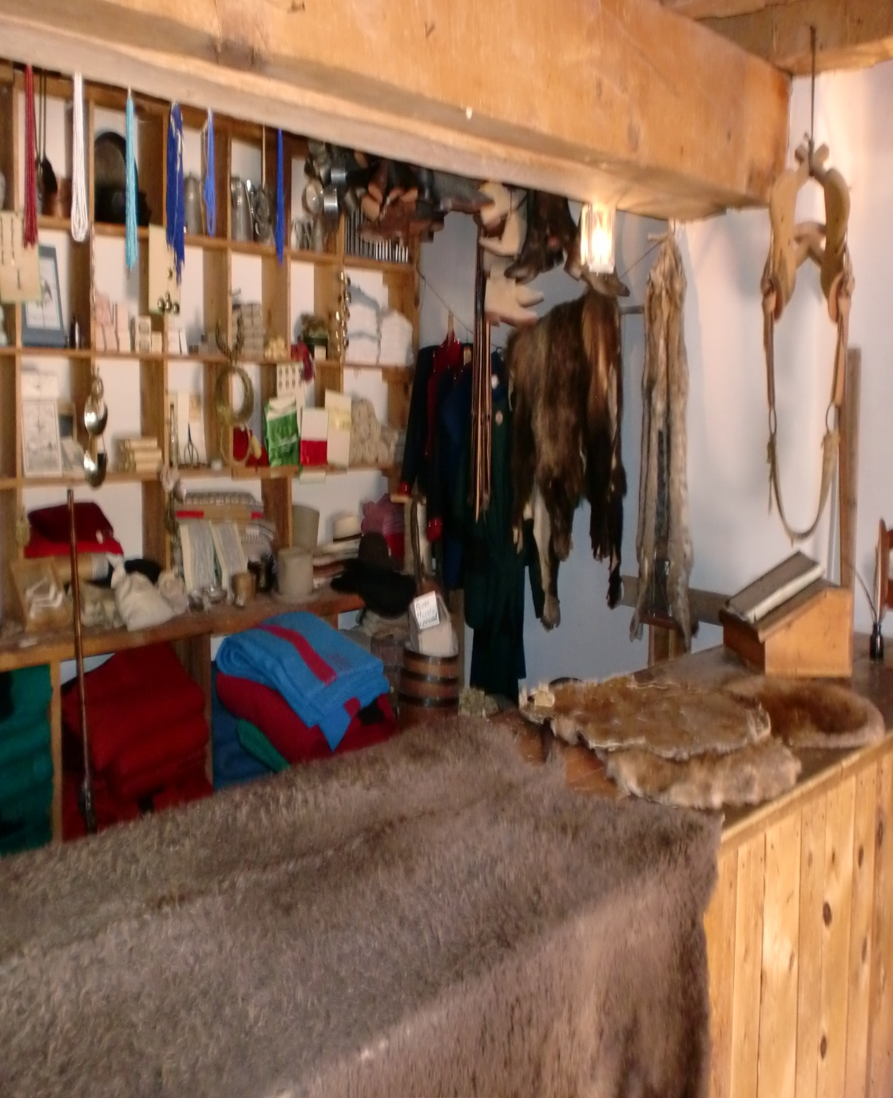
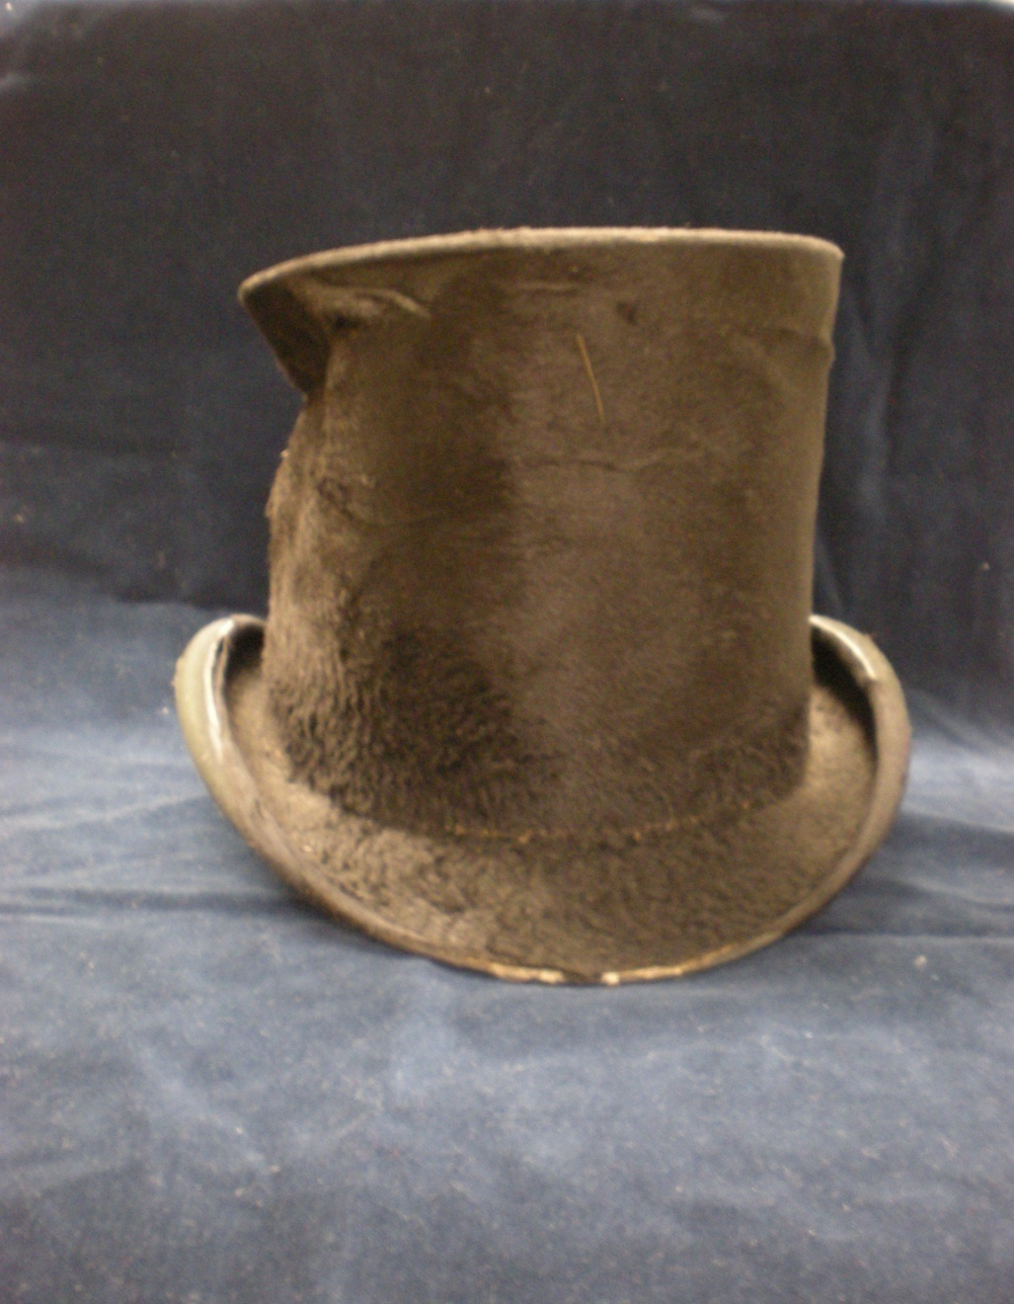
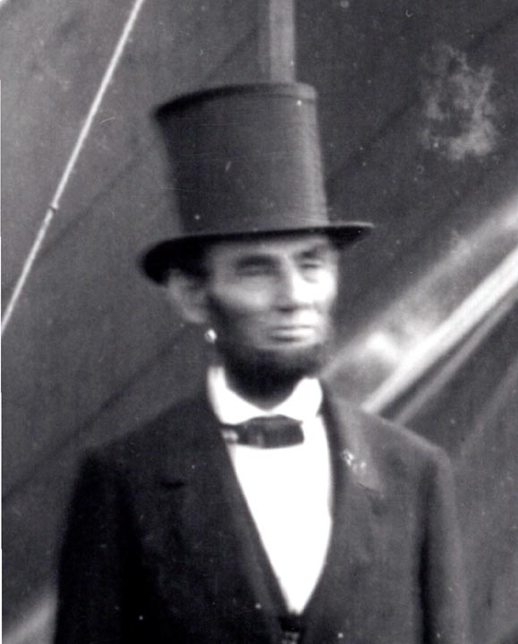
Mountain Men Open Up Paths
This western area was wild, untamed and dangerous areas
Expansion started slowly at first
Mountain Men were the first to venture and establish a permanent presence
Lived with and adopted customs from the native tribes they met
Fur trade
Resulted in first millionaire in the U.S.
Opened up trails and maps for others after them to follow

Slide 7
Missionaries
Much like the early conquerors before them, several missionaries within the U.S. felt they had the obligation to go and ‘civilize’ the natives, and teach them about the ‘correct’ religion.
Traveled mostly to Oregon
Wrote back to family and friends about the bountiful and fertile land for the taking.
Do we see any inherit racism in the beliefs of the missionaries?

Slide 8
Oregon Fever
Set off waves of migration westward along the Oregon Trail, a 2,000 mile long trek from Missouri across the Great Plains and the Rocky Mountains to the Oregon Valley.

Slide 9
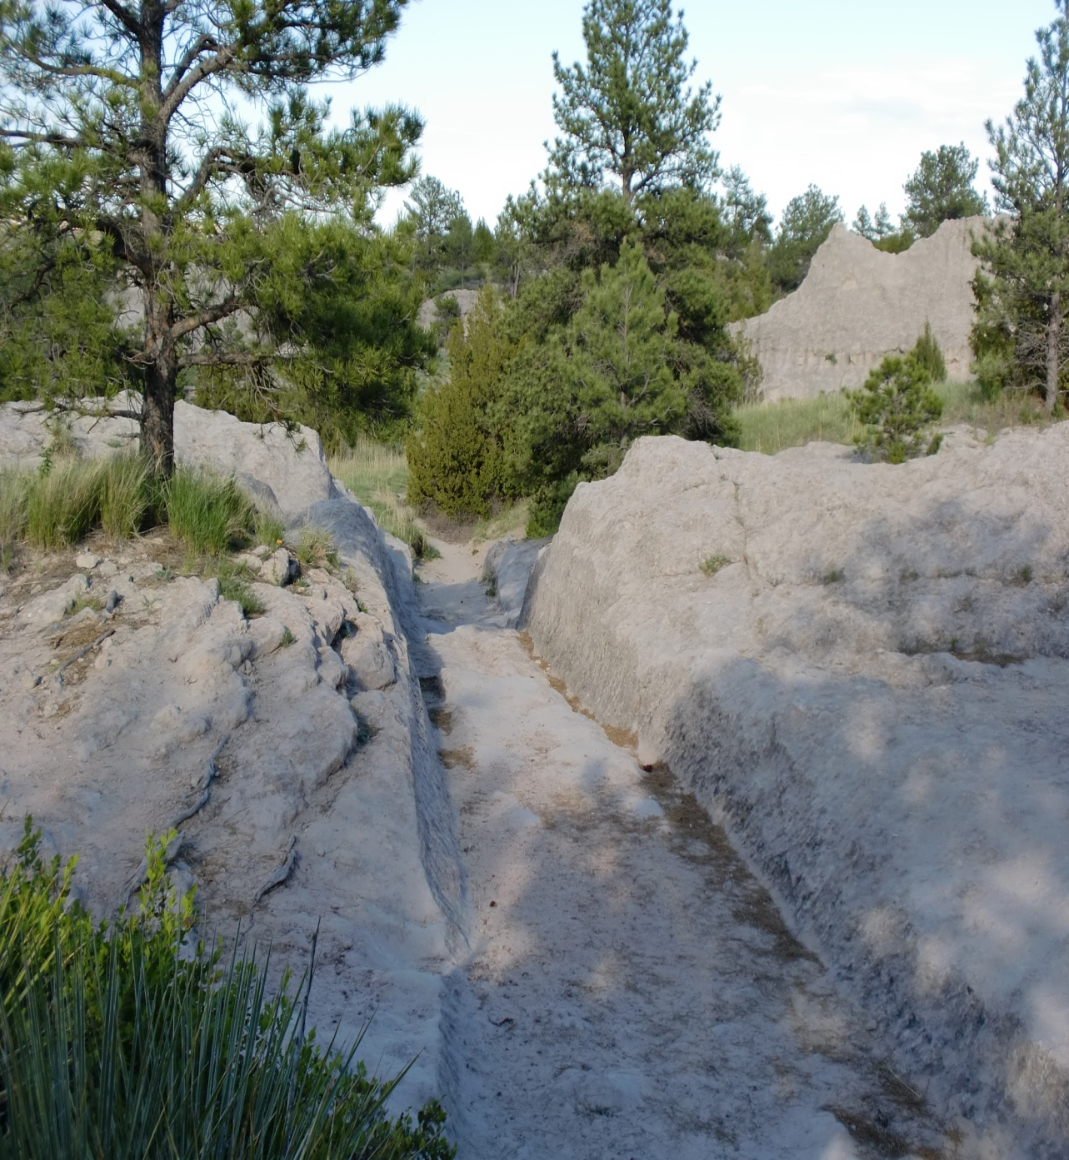
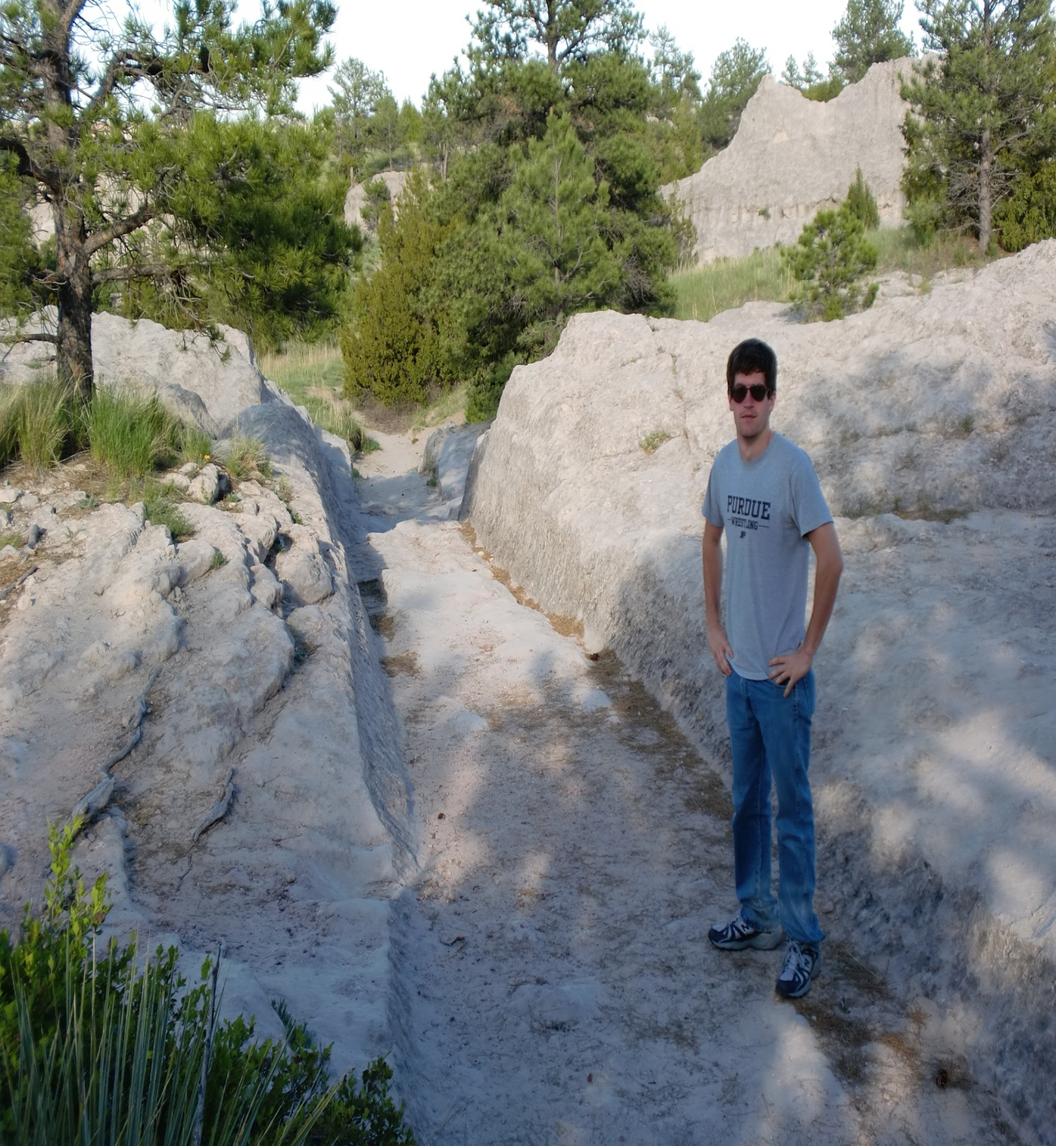
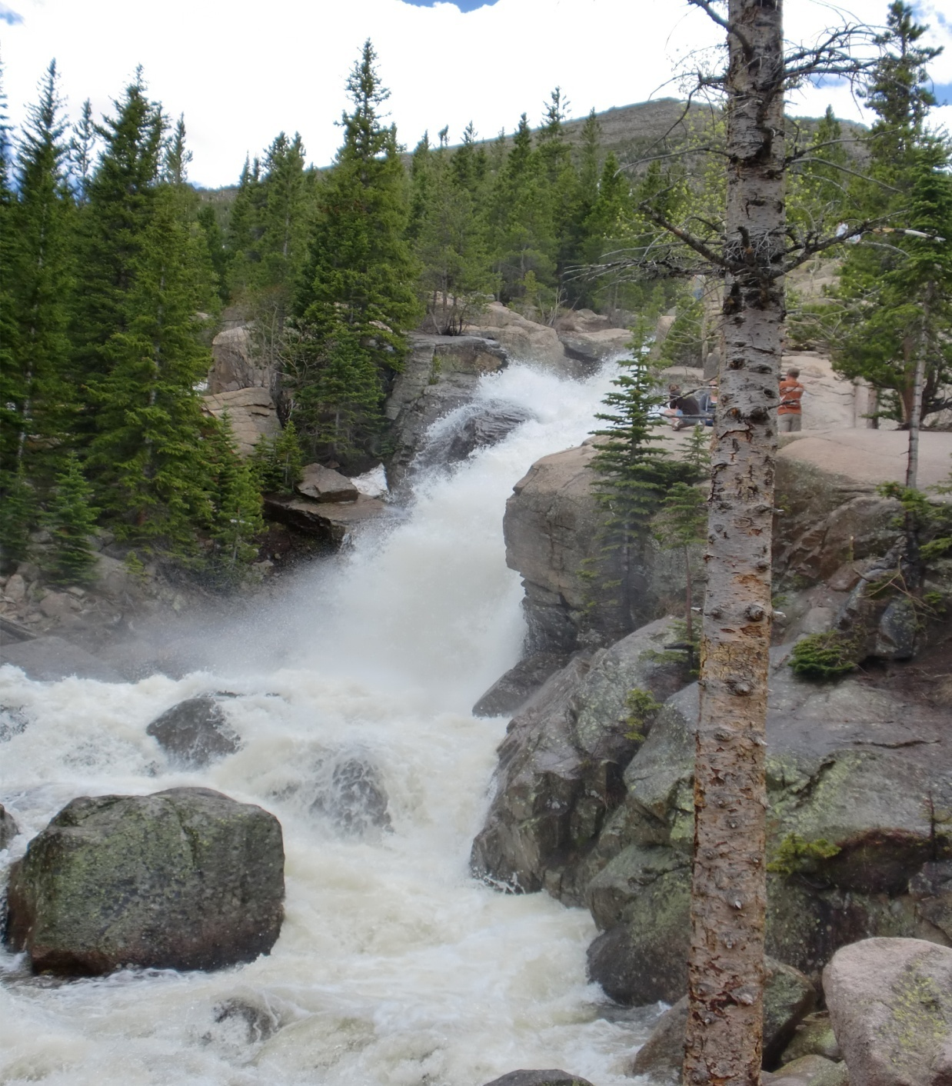
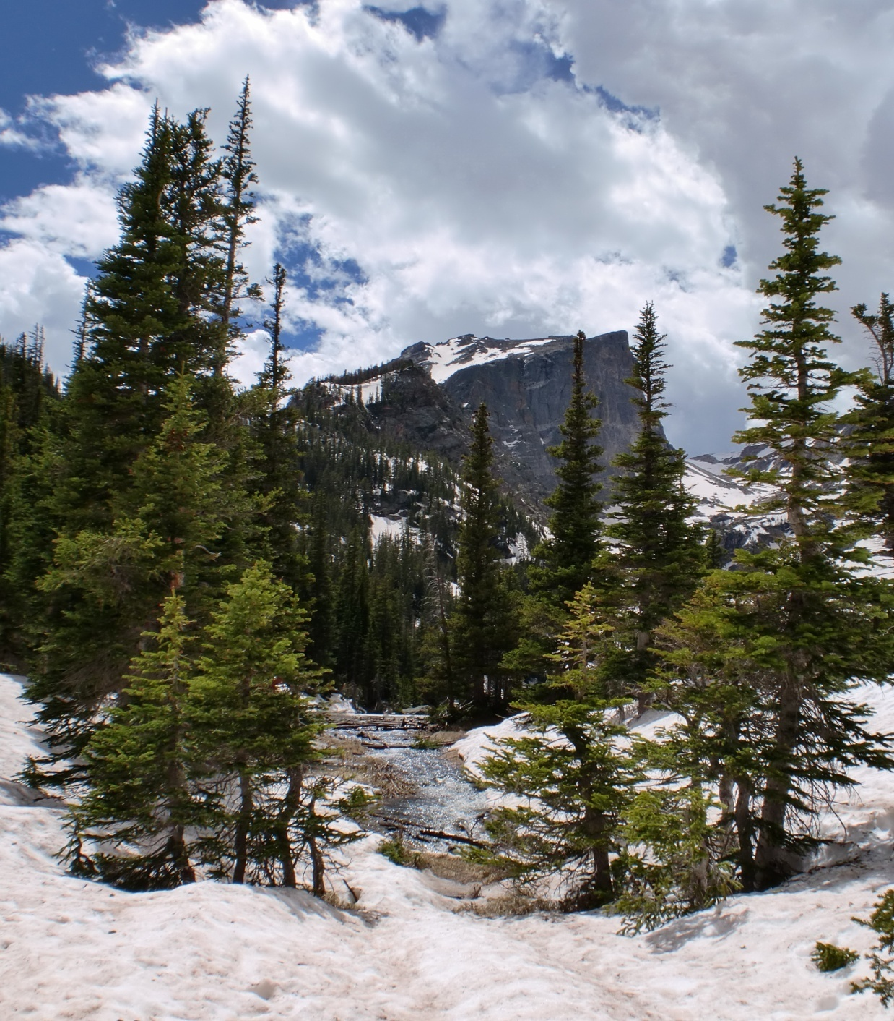
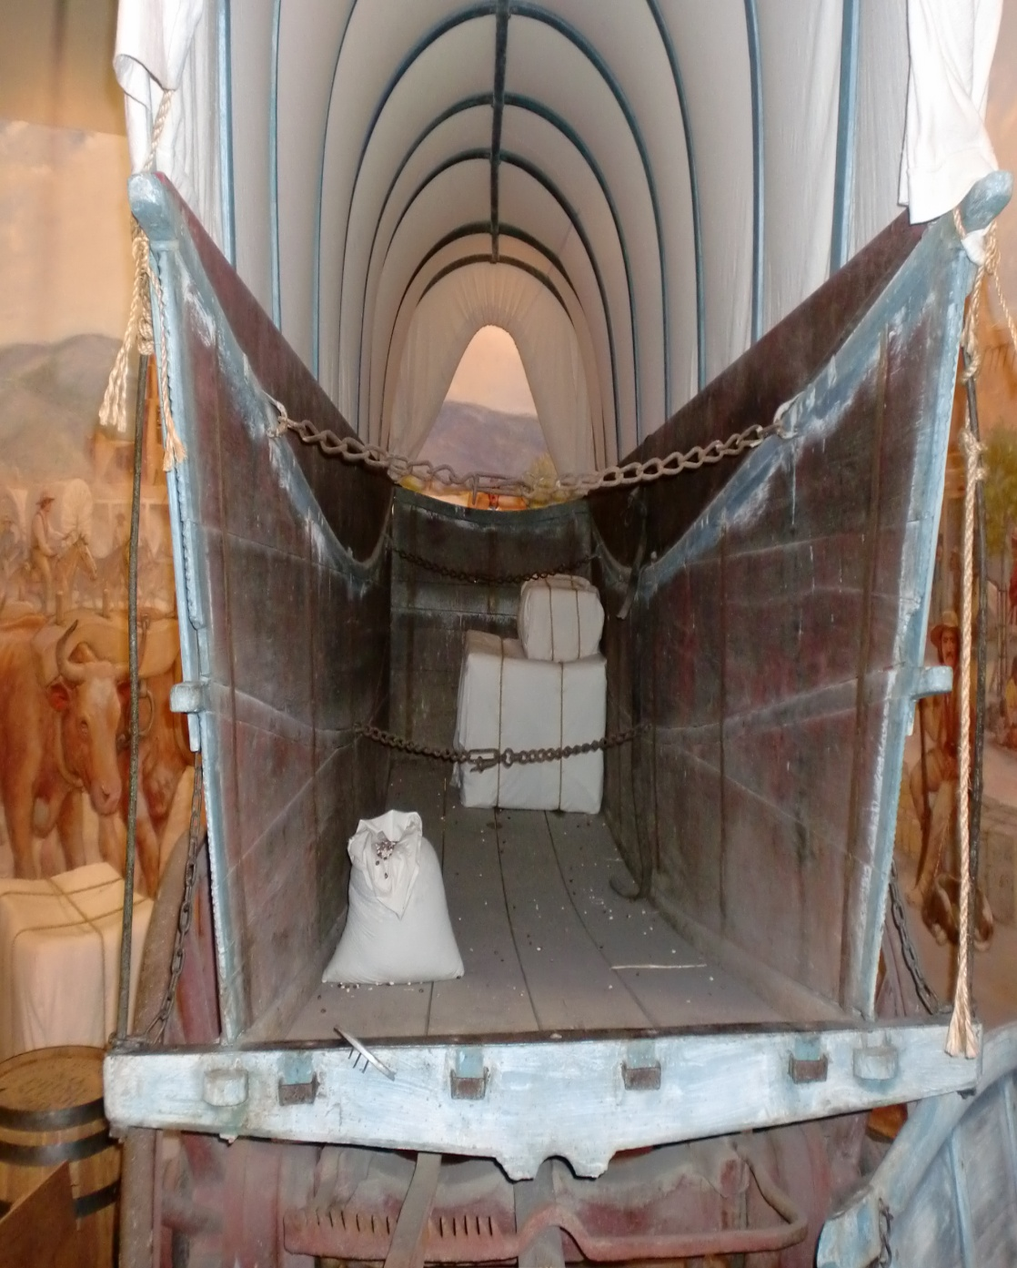
Oregon Fever
Families, loaded up everything they owned into wagons the extremely difficult journey west.
River Crossings
Mountains
Storms/Weather
Native Attacks
DISEASES: most serious and deadly problem faced by pioneers

Slide 10
With the U.S.’ goal of achieving Manifest Destiny, what other nation is standing in the way?
Mexico !

Slide 11
Texas
Mexico had let American settlers come in and become citizens
Texan settlers took advantage of the weaker Mexican government thousands of miles away
Did not follow Mexican law (slavery outlawed in Mexico)
Not given representation in the Mexican government
Dictator Santa Ana came to power and exerted tighter control over the Texans
YOU DON’T MESS WITH TEXAS!

Slide 12
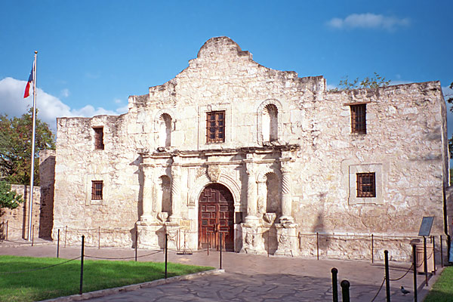
Texas
Despite the defeat of the Texan defenders at the Alamo, Texas does earn its independence.
Texas is actually its own country for a while
But almost immediately, Texas starts petitioning for entrance into the Union

Slide 13
TEXAS
Based on what we know about the Missouri Compromise, what regions would NOT want Texas to join the U.S.?
- The North was upset about the prospect of another slave state in the union, but Texas joins the U.S. in 1845

Slide 14
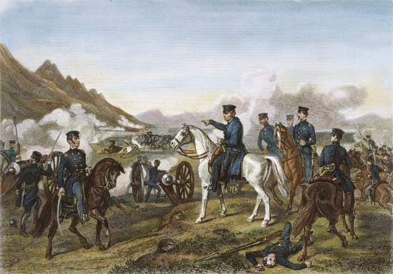
Mexican War
James K. Polk is elected for his strong support for Manifest Destiny and expanding into Mexico’s Territory
Offers to buy, but Santa Ana refuses
Provokes a war over the disputed Texas border
“American blood has been spilt on American soil”
Support for “Mr. Polk’s War” was weak in the north since it was seen as allowing for the expansion of slavery

Slide 15
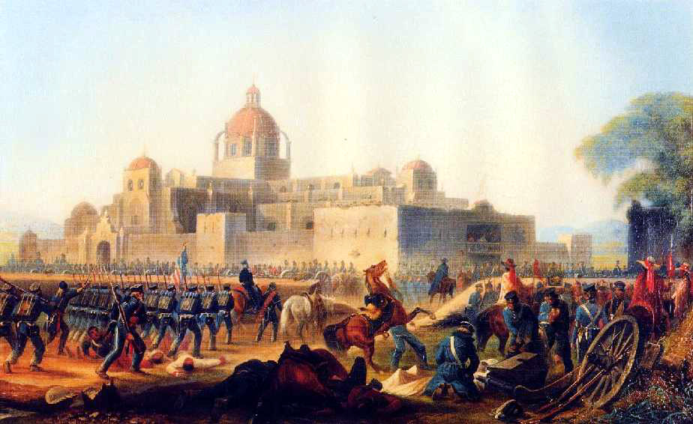
Mexican War
Buena Vista Palo Alto Cerro Gordo | In all of these battles, the American forces were significantly outnumbered. However, the more professional and industrial U.S. was able to win HUGE victories
Vera Cruz
Mexico City
Mexican War does not last very long (1846-1848)
Mexico: Very large army
U.S.: Better trained and equipped force

Slide 16
Effects of the Mexican War
War ends with the Treaty of Guadalupe Hidalgo
Boarder of Texas set
Mexico forced to give up large parts of their northern territory
Young U.S. officers gain valuable combat experience
Lee
Grant
Sherman
Jackson

Slide 17
Mission Accomplished!
Polk also buys Oregon Territory from Great Britain, and this along with the Mexican Cession, the U.S. now owns all of the territory between the Atlantic and Pacific Oceans
Manifest Destiny Achieved!

Slide 18
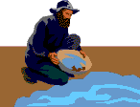
Motivating Factors
Frontier life was still dangerous and difficult, thinking back to reasons for original colonization, what do you think some reasons people would leave their homes in the advancing east for the perils of the west?
Religion
Economic Gain

Slide 19
Mormons
A new religion that had started in America, the Church of Latter Day Saints, or Mormons found themselves persecuted against in Missouri and Illinois
Largely for their practice of polygamy
Founder of the religion was murdered and killers never brought to trial
Mormons were actually outlawed in Missouri

Slide 20
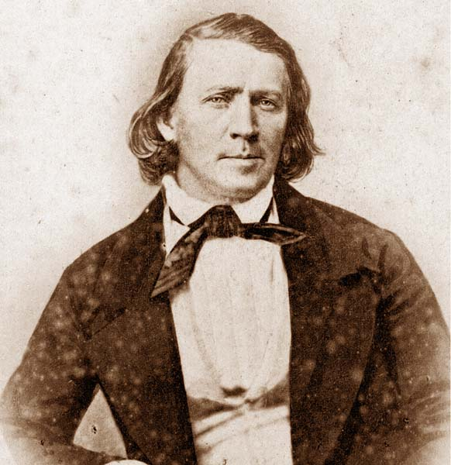
Mormons
New leader of the church, Brigham Young, decided that the only way for Mormons to survive and thrive was to move to the west and establish a new settlement in the wilderness
Young led the Mormons overland to the new promised land, Utah, using handcarts and made “the desert bloom”

Slide 21
Gold Fever
What brought tens of thousands more to the west was the prospect of economic opportunities.
When gold was discovered at Sutter’s Mill in northern California in 1849, tens of thousands of hopeful millionaires flocked to the gold fields to strike it rich
Since they came to California when they did, what would be a good nickname for these individuals?

Slide 22
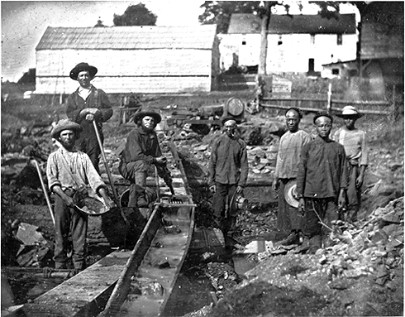
Gold Fever
Very quickly the population of California explodes!
Population grows from 14,000 to 100,000+ from 1848-1850
Very Diverse population
40% in CA are foreign born
45,000 from China immigrate the “Golden Coast” in hopes of making their fortune
Faced prejudice
Crucial in formation of the west

Slide 23
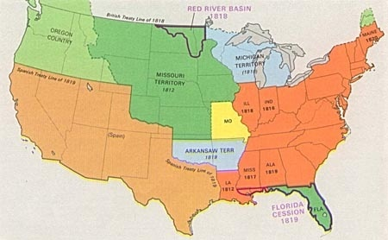
Free or Slave California?
With its huge and growing population, California can apply for statehood? Do you think it will come in as a free state or a slave state? Why?

Slide 24
Free or Slave California?
49ers, who work hard on finding their own fortune, did not like the idea of slave owners having their “property” the rivers; so most Californians were opposed to slavery. WESTWARD EXPANSION PUSHED SLAVERY TO THE BREAKING POINT. Missouri Compromise wasn’t going to keep the peace.

